Slide 1

DATA 606 CAPSTONE PROJECT SENTIMENT ANALYSIS ON YELP DATASET REVIEWS
ARJUN REDDY SEELAM
Spring 2021

Slide 2
Cleaning the final data
Perform cleaning of the review text by removing stop words and any special characters that are not required for analysis.
Applying “lemma” helps us to find the base word and helps in removing the endings of the word.
Apply cleansing by removing spaces, URL addresses, quotations, special characters.
Applying ”Polarity” (Polarity is float) which lies in the range of [-1,1] where 1 means positive statement and -1 means a negative statement.
Applying ”Subjectivity” Subjective sentences generally refer to personal opinion, emotion or judgment whereas objective refers to factual information.
In the end, find the word count, word density, unique words, average word length for the reviews.

Slide 3
Performing EDA
Top 5 cities with the greatest number of reviews:
Las Vegas – 29,770
Phoenix – 10,241
Toronto – 7,370
Scottsdale – 5,531
Charlotte – 5,467
Based on grouping the review stars for the entire data:
5-star rating reviews has the less mean length
5-star rating reviews has less stop words
5-star rating reviews has less words
After performing EDA, convert the EDA into a new csv file.

Slide 4
LGBM Model Training
LGBM (Light Gradient Boosting Method) combines the predictions from multiple decision trees to generate final predictions. Every successive decision tree is built on errors of previous tree.
Advantages:
Leaf – wise tree growth
Faster training speed and higher efficiency
Better accuracy than any other boosting algorithm
Compatibility with Large Datasets

Slide 5
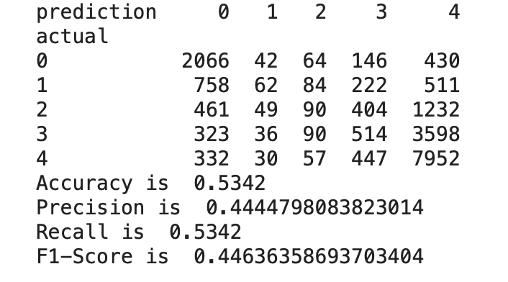
LGBM Value loss
After performing LGBM for 10,000 iterations, the training’s multi_loss is decreased from 1.007 to 0.430, Valid 1’s multi_loss is decreased from 1.105 to 0.860
After applying the prediction on test set, the prediction vs actual table is shown on the side.
The values obtained are as follows:
Accuracy: 53.42%
Precision: 44.44%
Recall: 53.42%
F-1 Score: 44.63%

